Slide 1

Air tank installation instructions
Included parts:
Raw aluminum air tank bracket
5/16-18 button head bolts (qty 4)
M8x1.25 button head bolts (qty 4)
M8 washers (qty 4)
M8x1.25 flange nuts (qty 4)
Tools needed for installation:
Rachet
12mm socket
13mm socket
5mm allen wrench
3/8 allen wrench
Center punch
Stepped drill bit
Cordless drill
Interior panel puller

Slide 2
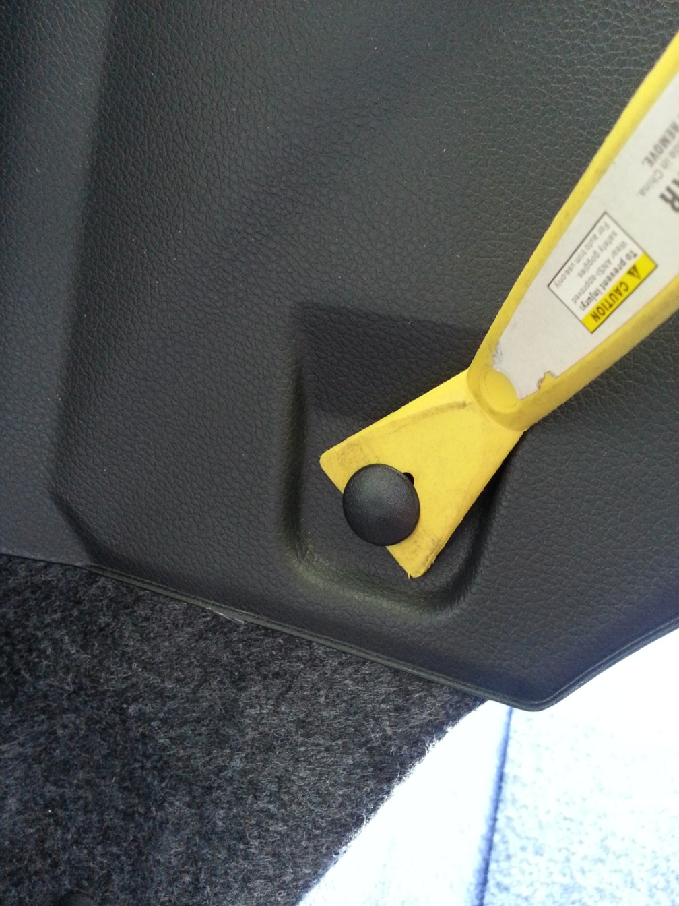
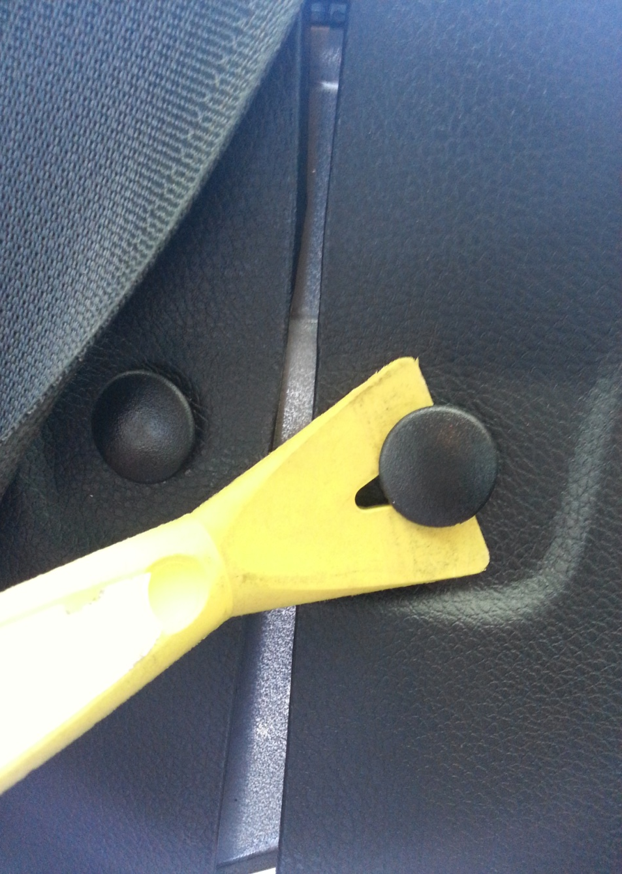
Step 1 – Lower the back seat to expose the 5 interior panel clips that will need to be removed. Use your panel puller took to remove them.

Slide 3
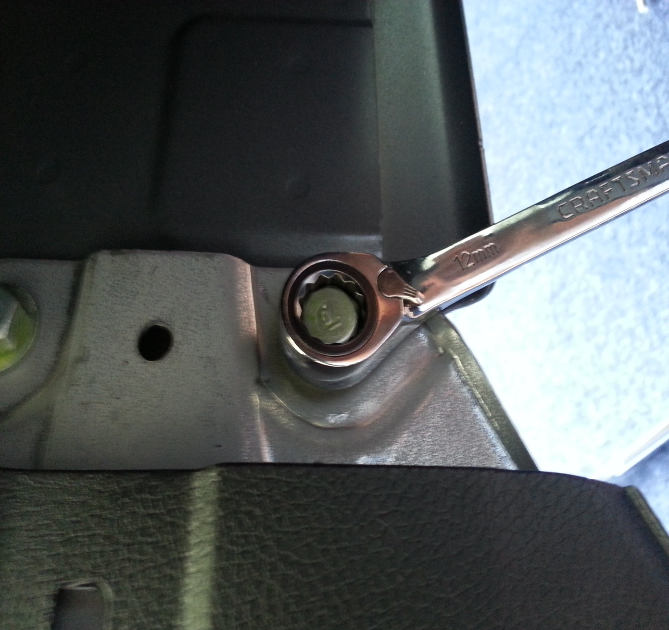
Step 2 – Next, lift the edge of the plastic panel to expose the 12mm factory bolt that needs to be removed. There are 2 that need to be removed.

Slide 4
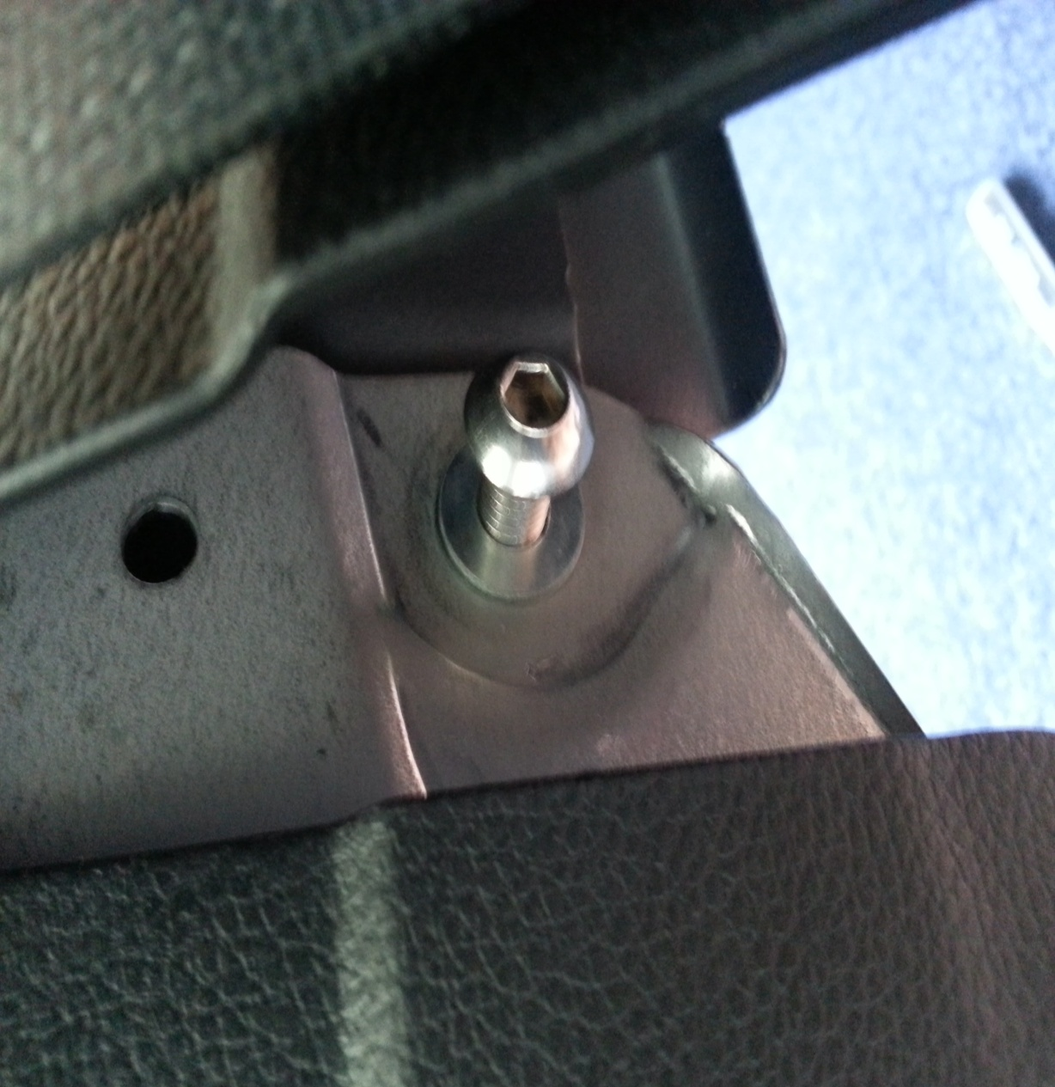
Step 3 – After you have removed the factory bolt, replace it with the supplied M8x1.25 button head bolt and washer.

Slide 5
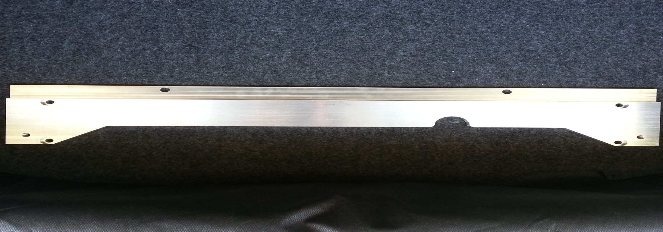
Step 4 – Now get your bracket and flip it over so the recessed holes are facing towards you. Take the supplied 5/16 bolts and your EXO mounts and bolt these together.

Slide 6
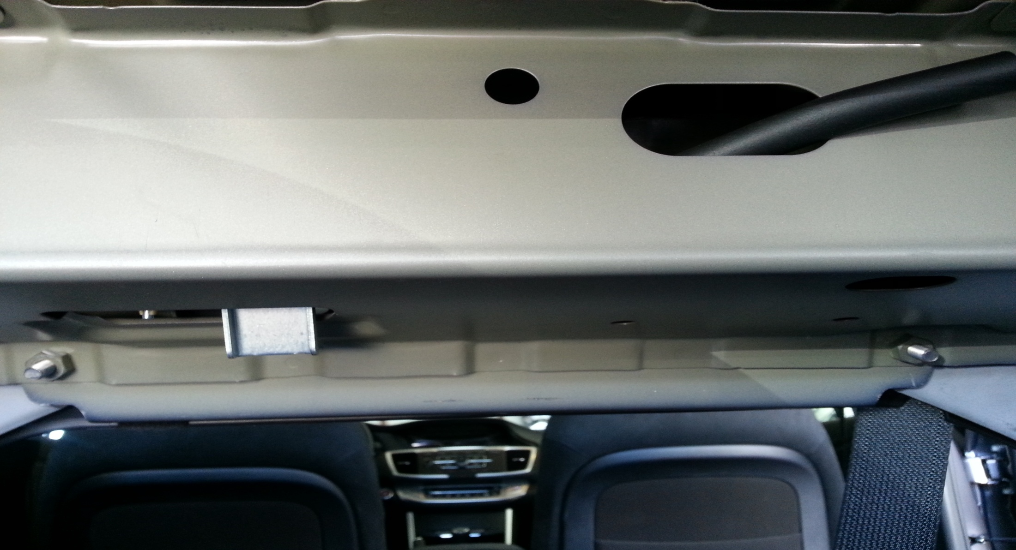
Step 5 – Here you can see the two new bolts that were installed in Step 3, take you FFC bracket with the EXO mounts installed and slide it over the exposed thread of the bolts. Install the supplied M8 flange nuts and tighten by hand.

Slide 7
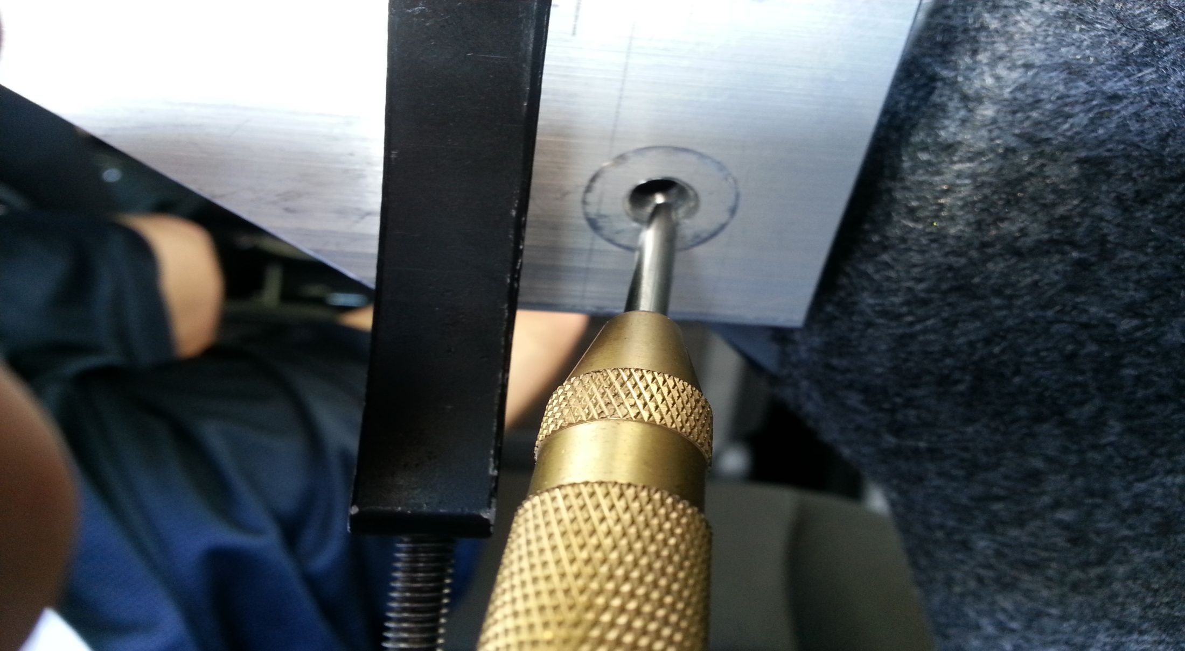
Step 6 – Now take your center punch and mark where to drill. After you have center punched the hole, go ahead and remove the FFC bracket.

Slide 8
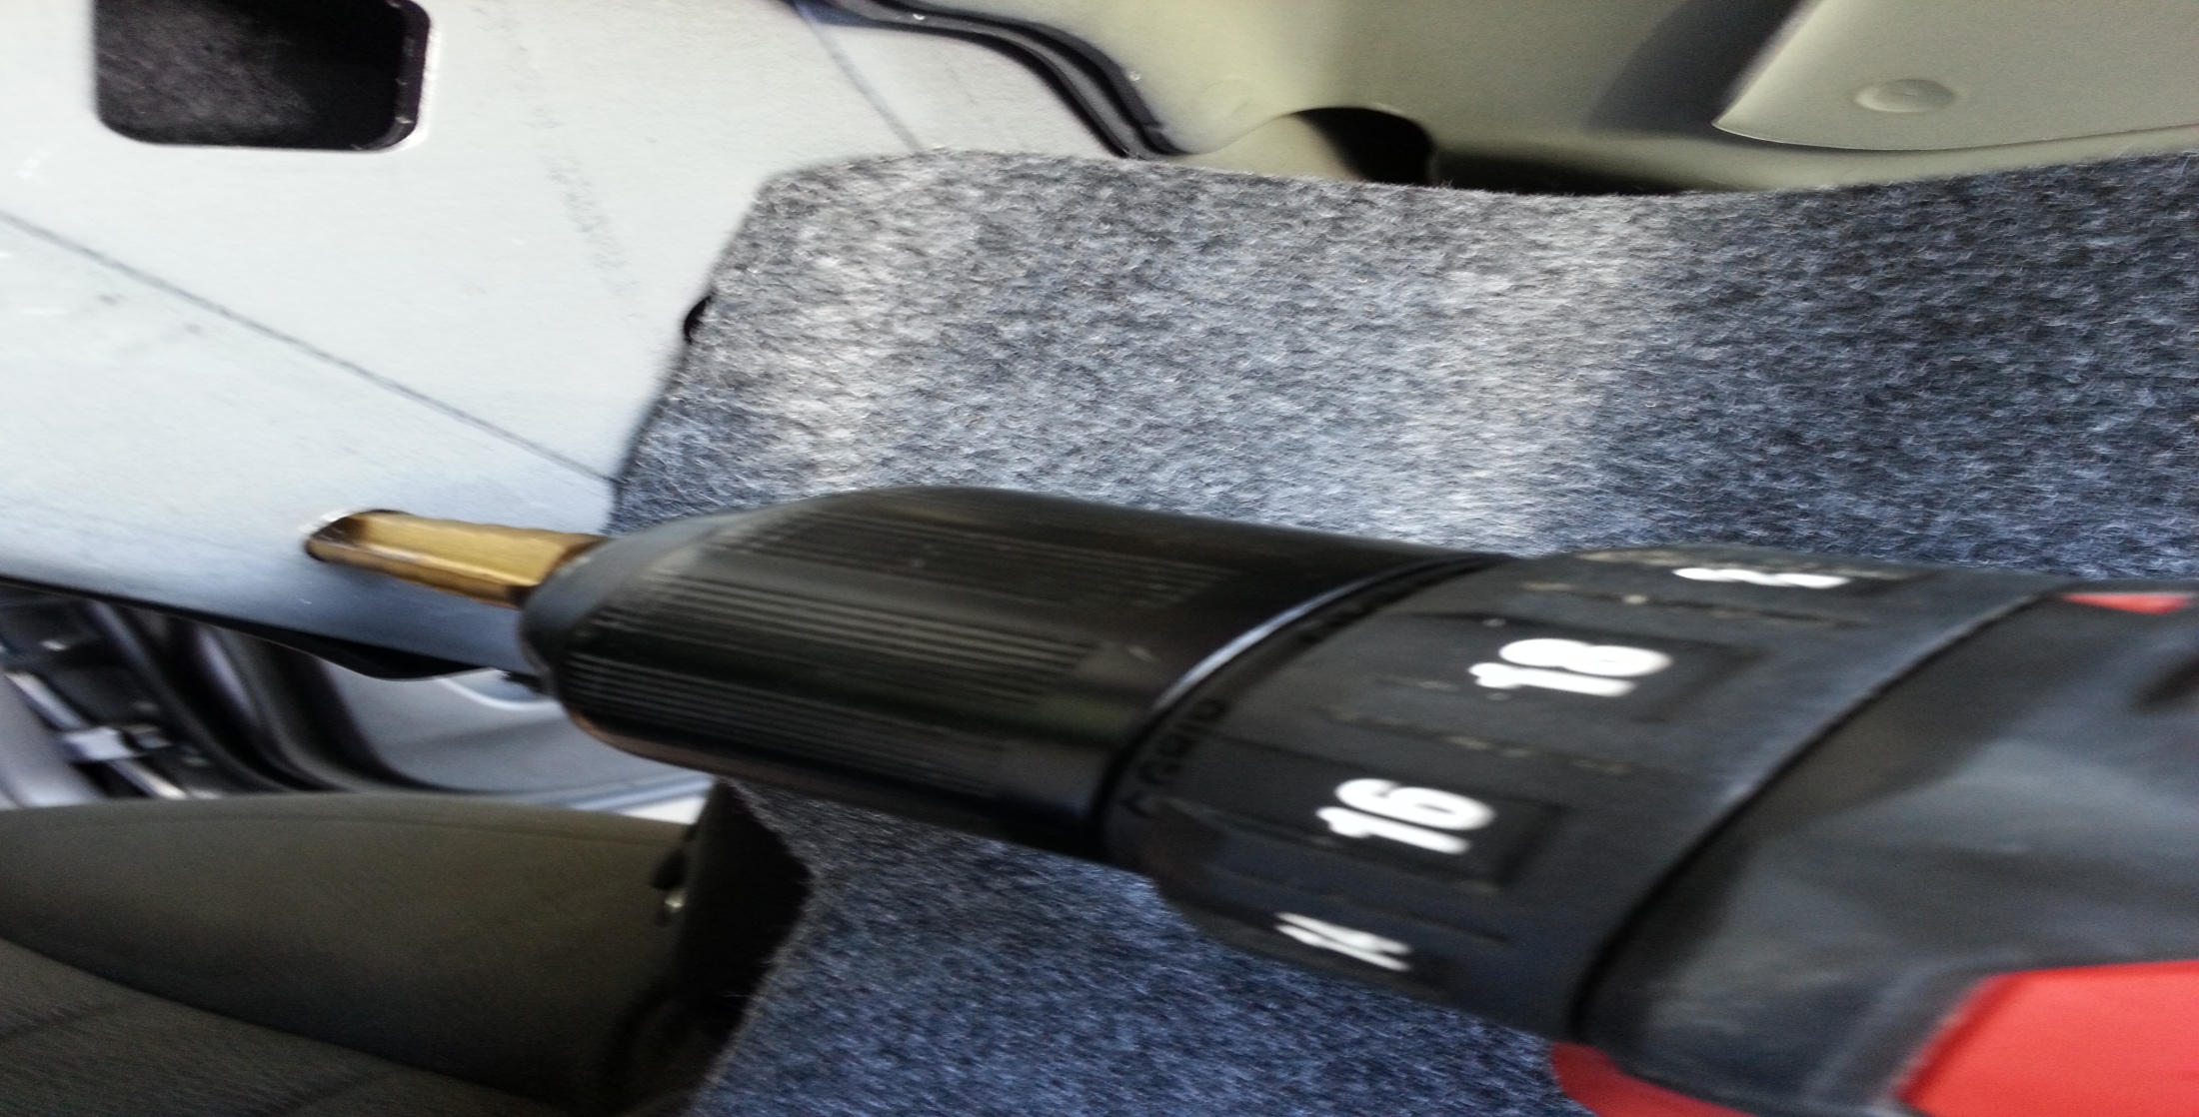
Step 7 – Get your stepped drill bit and cordless drill, find your center punch mark and begin drilling. *Be sure you hold the plastic panel on the other side to prevent from drilling into it. Depending on how perfect your center punch hole is you may need to enlarge the hole slightly. Start with a 3/8 inch hole, if that doesn’t work, then widen the hole by a 1/32nd of an inch at a time.
*Note: Go no larger than a 7/16th hole.

Slide 9
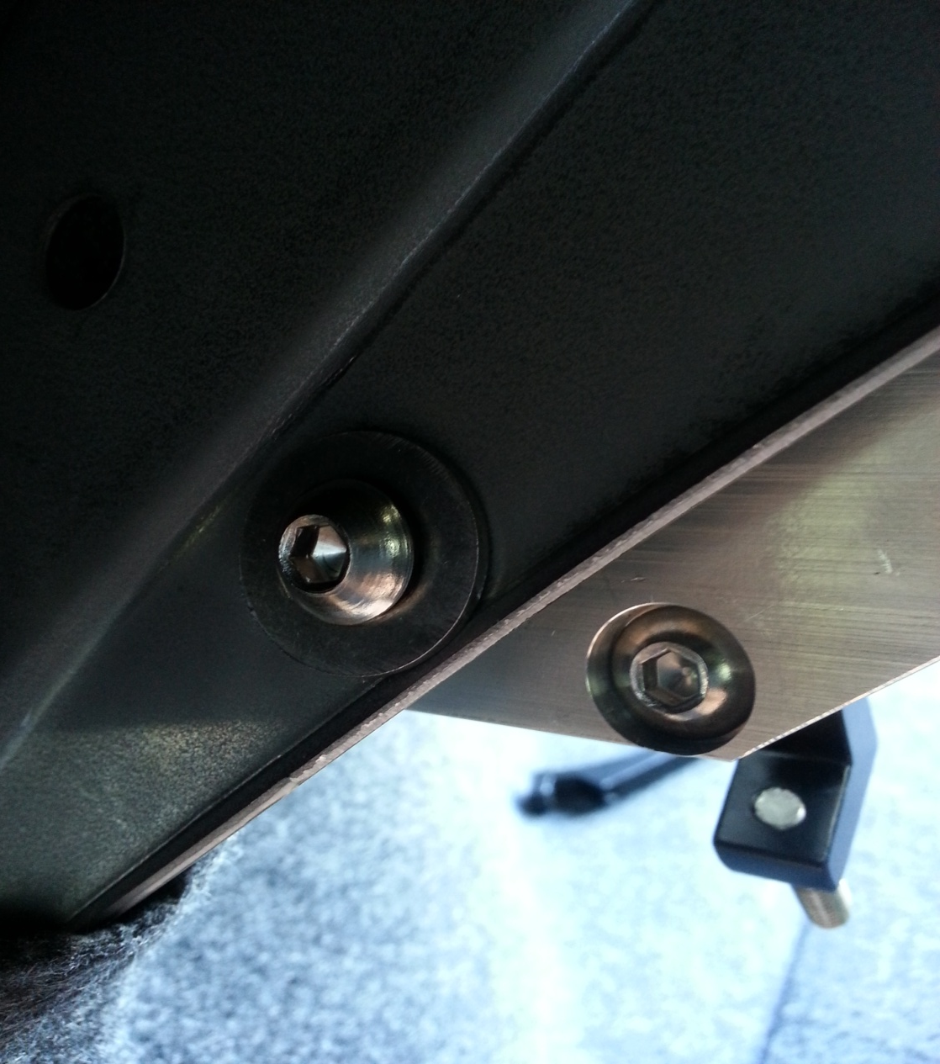
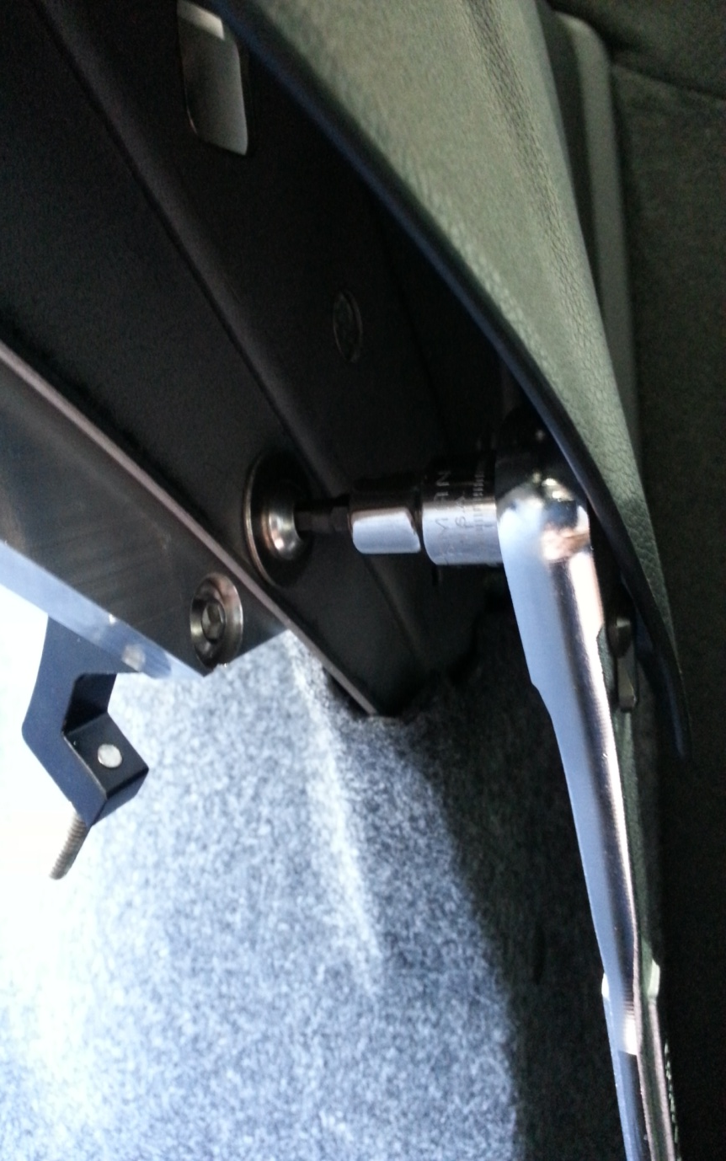
Step 8 – Re-install the FFC bracket and use the supplied M8 bolts and large washers, thread them into the bracket. Be sure to hole the FFC bracket tight to car as you tighten the bolts.

Slide 10
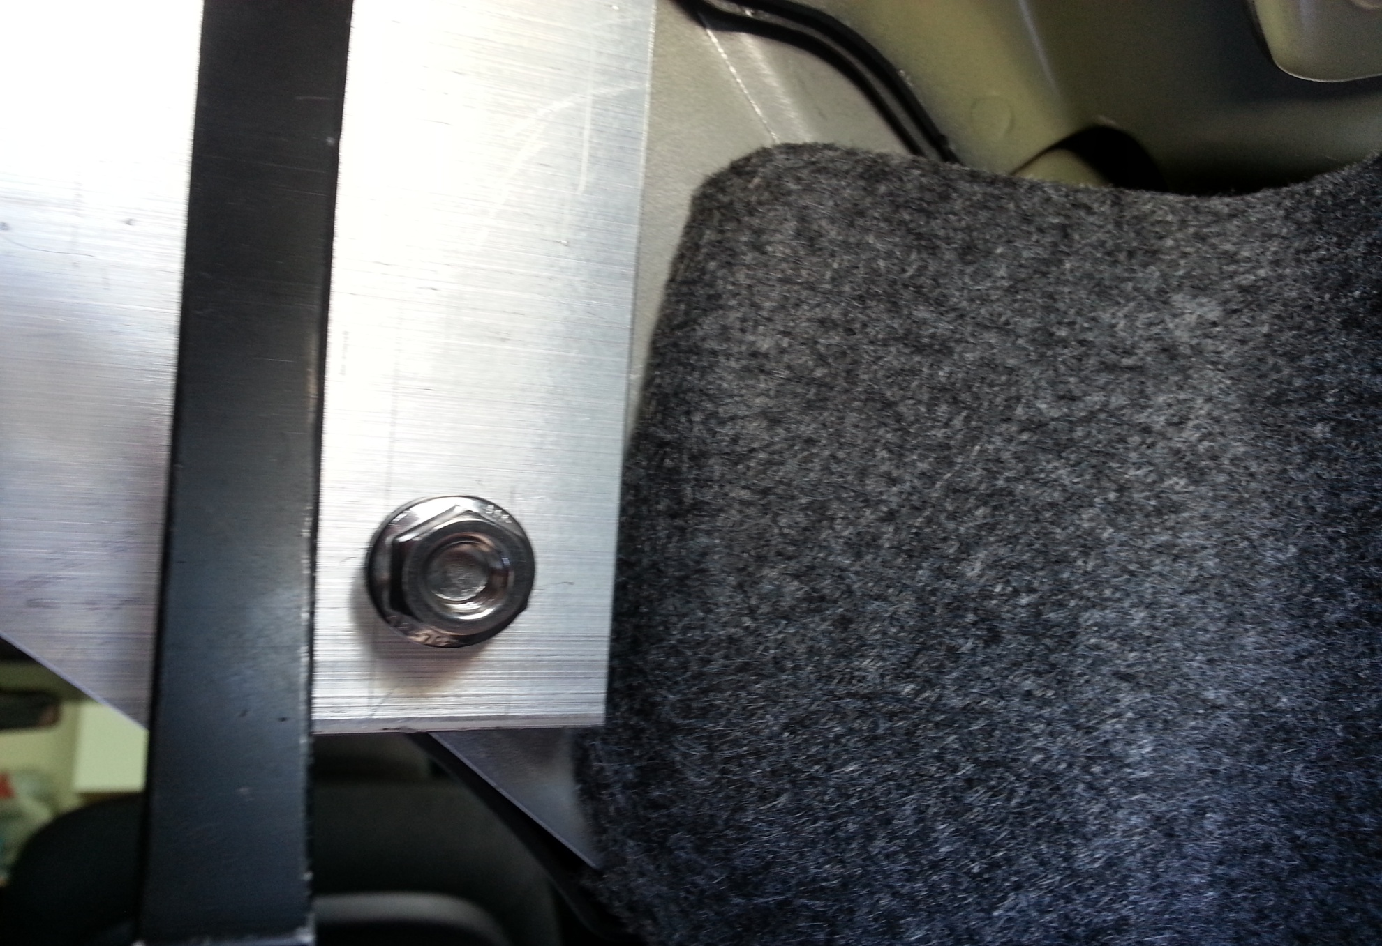
Step 9 – Now installed the supplied nuts onto the bolts that you just installed and tightened. Be sure the bolts are tight before installing the nuts.

Slide 11
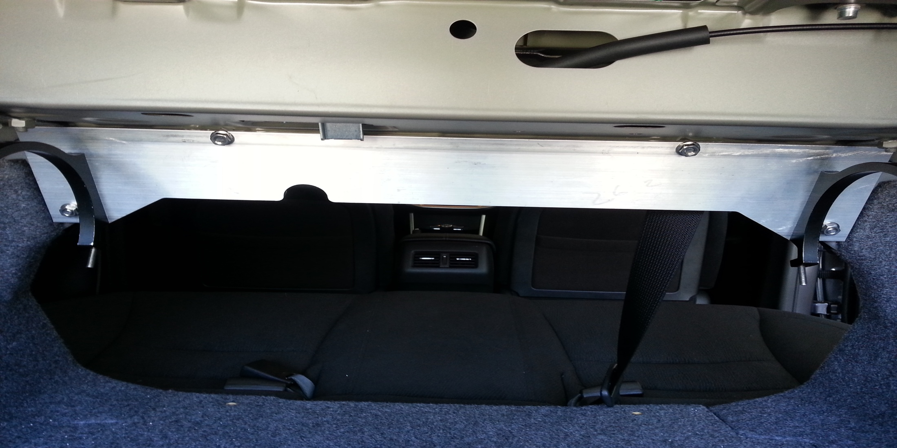
Step 10 – After you tighten the lower nuts, go ahead and tighten the upper nuts that were installed just hand tight.

Slide 12
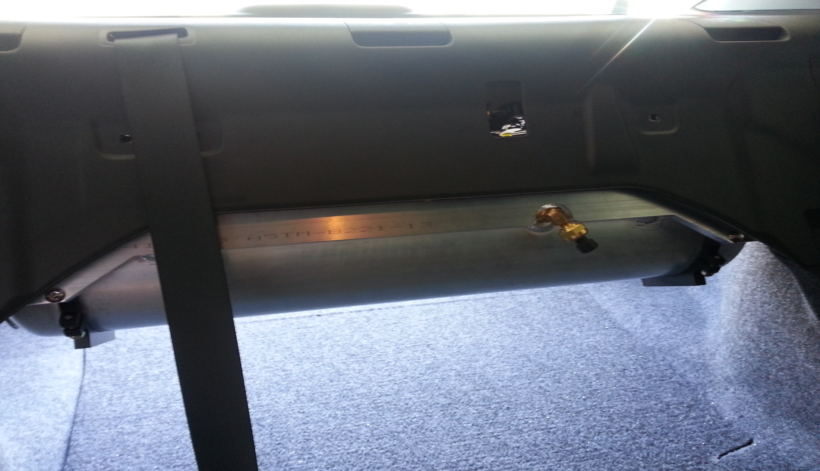
Step 12 – Be sure that when you install your air tank that you used the cut out for your pressure switch. Rotate the air tank until you have it the correct way.

Slide 13
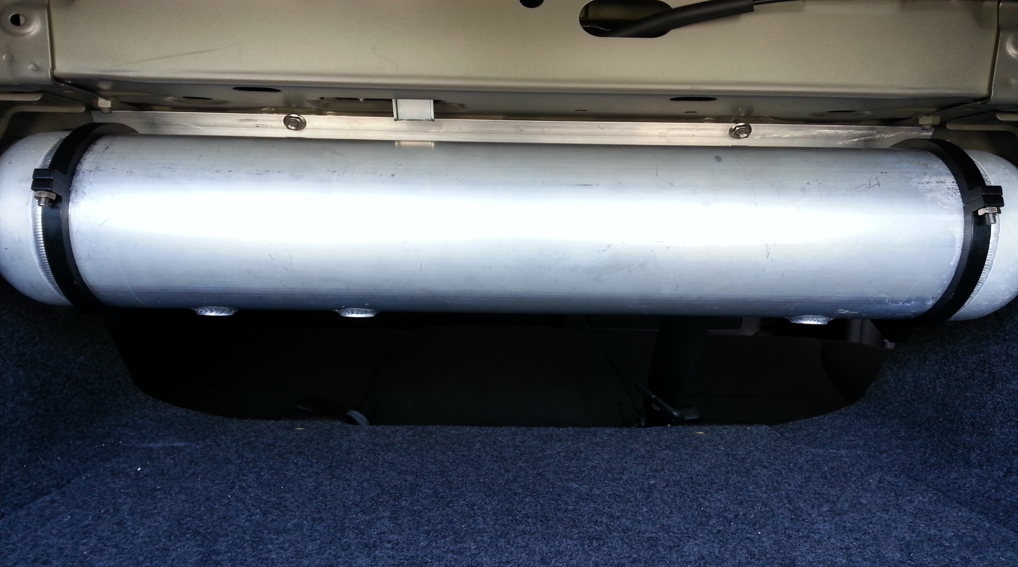
Step 12 – Install your air tank, Congratulations you are finished installing your new FFC air tank bracket.

